Slide 1
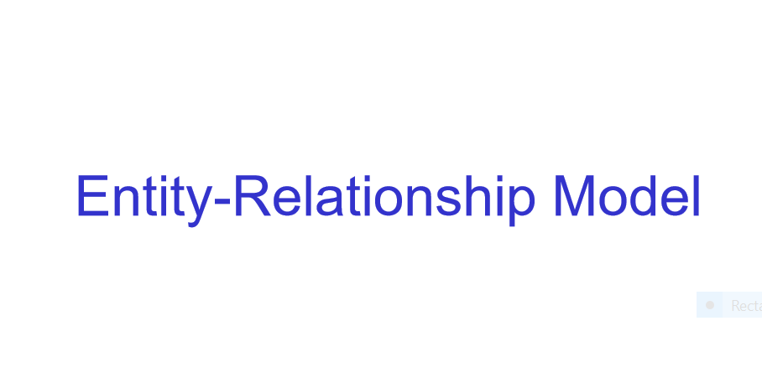
Notes:
The E/R model was developed by Peter Chen in 1976 and E-R modeling is a conceptual level model.

Slide 2
Database Design
Goal of design: generate a formal specification of the database conceptual schema.
Methodology:
Use E-R model to get a high-level graphical, conceptual view of the essential components of the enterprise and how these components are related
then convert the E-R diagram to SQL DDL, or whatever database model you are using
E-R Model is not SQL-based. It's not tied to any particular logical implementation of a DBMS. It is a conceptual and semantic model, which attempts to capture meanings rather than an actual implementation
Notes:
DO NOT THINK OR START WITH TABLES--YOU WILL BE MISGUIDED ON RELATIONSHIPS AND SOME ATTRIBUTES.

Slide 3
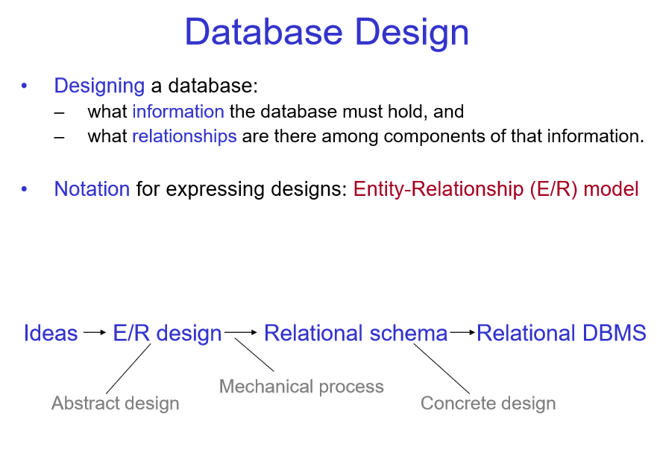

Slide 4
Entity Sets
Entity = “thing” or object.
Example: CSC 370, CSC 230, CSC 226 etc.
Entity set = collection of similar entities. (We model a set of courses as given above by the entity set course). When we say ‘entity’ what we actually mean is the entity set or an entity type
Similar to a class in object-oriented languages.
Attribute = property of (the entities of) an entity set. Attributes of the course entity could be name and course code/id
Attributes are simple values, e.g. integers or character strings, not structs, sets, etc.

Slide 5
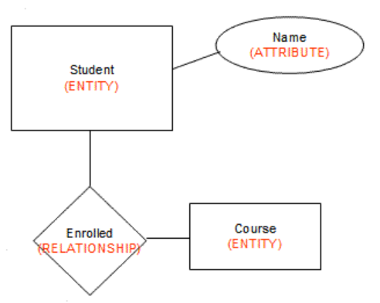
The E-R Model
The enterprise is viewed as set of
Entities
Relationships among entities
Symbols used in E-R Diagram
Entity – rectangle
Attribute – oval
Relationship – diamond
Link - line
We model the potential relationship. Not all entities from a set necessarily connect/relate to another entity in another set
Notes:
Just like the Newtonian model in Physics was created to explain the interaction between physical bodies we have the ER model to explain the interaction between objects in an organization. So, in the Newtonian model we have abstractions like particles on which we apply Newton’s laws similarly we have abstractions like entity, relations among entities and attributes to model an organization ( or rather activities of an organization in which we are interested in)

Slide 6
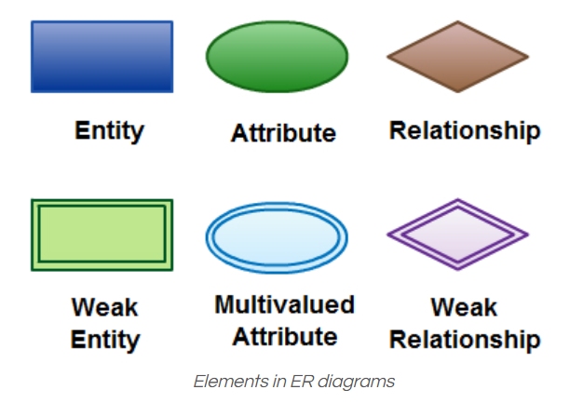
ER Diagram Symbols and Notations
Notes:
Copied from https://creately.com/blog/diagrams/er-diagrams-tutorial/
There are three basic elements in an ER Diagram: entity, attribute, relationship. There are more elements which are based on the main elements. They are weak entity, multi valued attribute, derived attribute, weak relationship, and recursive relationship. Cardinality and ordinality are two other notations used in ER diagrams to further define relationships.

Slide 7

ER Diagram Symbols and Notations
basic elements in an ER Diagram: entity, attribute, relationship
There are more elements which are based on the main elements. They are weak entity, multi valued attribute, derived attribute (oval with a dashed line), weak relationship, and recursive relationship

Slide 8
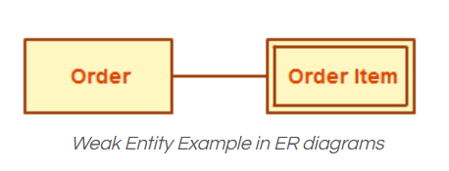
Entity & weak entity
Entity
An entity can be a person, place, event, or object that is relevant to a given system. A collection of similar entities is called an entity set. For example, a school system may include entity sets such as students, teachers, courses, etc. Entities (what is meant actually is the entity set) are represented in ER diagrams by a rectangle and named using singular nouns.

Slide 9
Entity & weak entity
Weak Entity
A weak entity is an entity that depends on the existence of another entity. In more technical terms it can be defined as an entity that cannot be identified by its own attributes. It uses an attribute of another entity combined with its own attributes to form the primary key. An entity like order item is a good example for this. The order item will be meaningless without an order so it depends on the existence of the order.

Slide 10
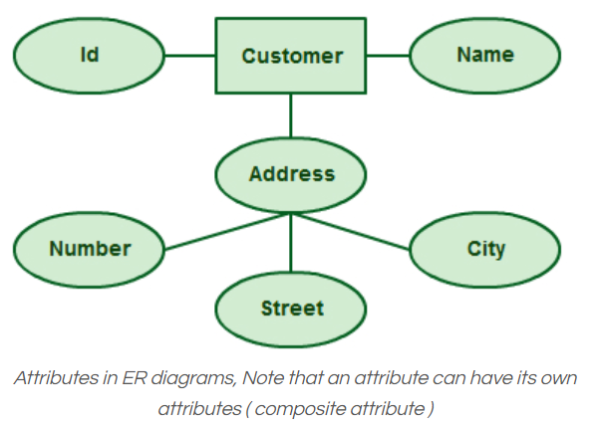
Attribute
An attribute is a property or a trait, or characteristic of an entity, relationship, or another attribute.
Could be either single-valued (Name) or multi-valued (a person can have more than one phone number, email_address, etc.)

Slide 11
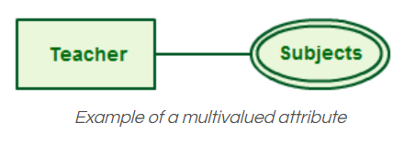
Multivalued Attribute
If an attribute can have more than one value it is called a multi-valued attribute and is different from a composite attribute like address of a person
Notes:
Observe the difference between composite and multivalued attribute. Composite means attributes of an attribute

Slide 12
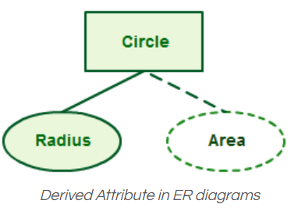
Derived Attribute
An attribute based on another attribute.
Other examples, age of a person from date of birth or average salary from salary

Slide 13
Entities Summary
Entity: an object that is involved in the enterprise and that be distinguished from other objects. (not shown in the ER diagram—it is an instance)
Can be person, place, event, object, concept in the real world
Can be physical object or abstraction
Ex: "John", "CSC370"
Entity Type or Set: set of similar objects or a category of entities; they are well defined (akin to an OO class). Ex. Person, course (what is shown in ER diagram)
A rectangle represents an entity set
Ex: students, courses
We often just say "entity" and mean "entity type“ or “entity set”

Slide 14
Attributes Summary
Attribute: describes one aspect of an entity type; usually [and best as] a single value and indivisible (atomic)
Represented by oval on E-R diagram
Ex: name, maximum enrollment for a course entity
May be multi-valued – use double oval on E-R diagram
May be composite – attribute has further structure; also use oval for composite attribute, with ovals for components connected to it by lines
May be derived – a virtual attribute, one that is computable from existing data in the database, use dashed oval. This helps reduce redundancy.
One or more attributes may be designated a key (next slide)

Slide 15
Keys
Superkey: an attribute or set of attributes that uniquely identifies an entity--there can be many of these
Composite key: a key requiring more than one attribute
Candidate key: a superkey such that no proper subset of its attributes is also a superkey (minimal superkey – has no unnecessary attributes)
Primary key: the candidate key chosen to be used for identifying entities and accessing records. Unless otherwise noted "key" means "primary key"
Alternate key: a candidate key not used for primary key
Secondary key: attribute or set of attributes commonly used for accessing records, but not necessarily unique
Foreign key: term used in relational databases (but not in the E-R model) for an attribute that is the primary key of another table and is used to establish a relationship with that table where it appears as an attribute also.

Slide 16
More about keys with an example
Candidate Key: are individual columns in a table that qualifies for uniqueness of all the rows. Here in Employee table EmployeeID & SSN are Candidate keys.
Primary Key: is the columns you choose to maintain uniqueness in a table. Here in Employee table you can choose either EmployeeID or SSN columns, EmployeeID is preferable choice, as SSN is a secure value
example of an Employee table:
Employee (
EmployeeID,
FullName,
DateOfBirth,
SSN,
DeptID,
MngID
);
Notes:
For ease of explanation we are using the table declaration of the entity Employee here. The entity Employee is modeled here with attributes: EmployeeID,
FullName, DateOfBirth, SSN, DeptID and MngID

Slide 17
More about keys with an example
3. Alternate Key: Candidate column other the Primary column, like if EmployeeID is PK then SSN would be the Alternate key.
4. Super Key: If you add any other column/attribute to a Primary Key then it becomes a super key, like EmployeeID + FullName is a Super Key.
example of an Employee table:
Employee (
EmployeeID,
FullName,
DateOfBirth,
SSN,
DeptID,
MngID
);

Slide 18
More about keys with an example
5. Composite Key: If a table do have a single columns that qualifies for a Candidate key, then you have to select 2 or more columns to make a row unique. Like if there is no EmployeeID or SSN columns, then you can make FullName + DateOfBirth as Composite primary Key. But still there can be a narrow chance of a duplicate row.
6. You create a Secondary Key to help you find rows in a different way that is probably more suitable to your business case other than by using the PK. An employee for example, may not remember his/her SSN but can remember his/her Family Name.
example of an Employee table:
Employee (
EmployeeID,
FullName,
DateOfBirth,
SSN,
DeptID,
MngID
);

Slide 19
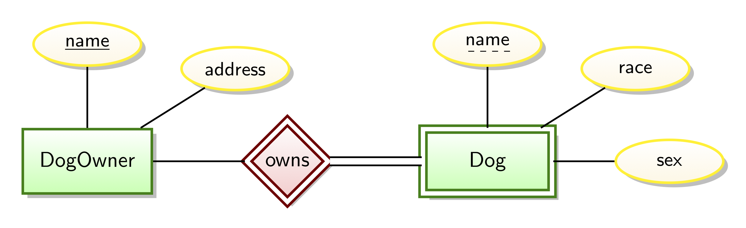
What is a partial key?
In Entity-Relationship modeling a partial key is an attribute of a weak entity type that combined with the identifying relationships will identify entities of the entity type.
Notes:
Copied from What is a partial key in database systems? https://www.quora.com/What-is-a-partial-key-in-database-systems

Slide 20
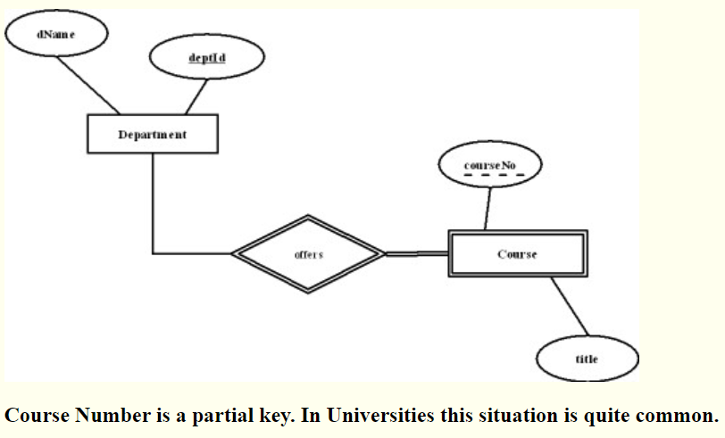
Another partial key example
Notes:
Link https://ion.uwinnipeg.ca/~rmcfadye/2914/hypergraph/partial.html

Slide 21
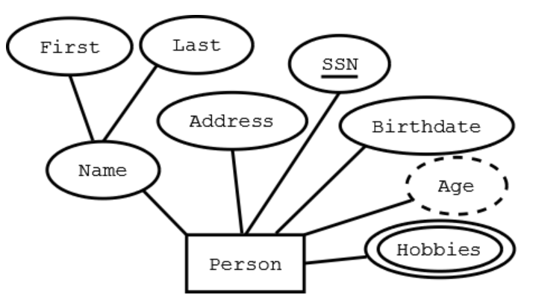
Graphical Representation in E-R diagram
Rectangle -- Entity
Ellipses/ovals -- Attribute (underlined attributes are [part of] the primary key)
Double ellipses/ovals -- multi-valued attribute
Dashed ellipses/ovals-- derived attribute, e.g. age is derivable from birthdate and current date.

Slide 22
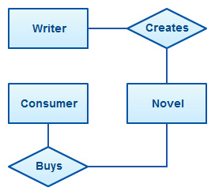
Relationship among entities
A relationship describes how entities interact and is represented by diamond shapes and are labeled using verbs. A relationship connects two or more entity sets.
It is represented by a diamond, with lines to each of the entity sets involved.

Slide 23
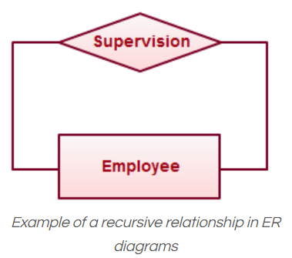
Recursive Relationship
If the same entity participates more than once in a relationship it is known as a recursive relationship.
an employee can be a supervisor and be supervised

Slide 24
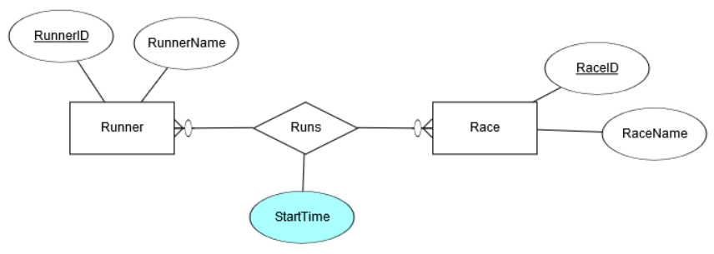
Relationship Set
A set of relationships of similar type is called a relationship set. Like entities, a relationship too can have attributes. These attributes are called descriptive attributes.
In an E/R diagram, can a relationship have attributes?
https://www.quora.com/In-an-E-R-diagram-can-a-relationship-have-attributes
Notes:
Check the Quora link for more examples. since the StartTime would be tied to both the specific runner and the specific race they were running it becomes an attribute of the relationship between the two entities

Slide 25
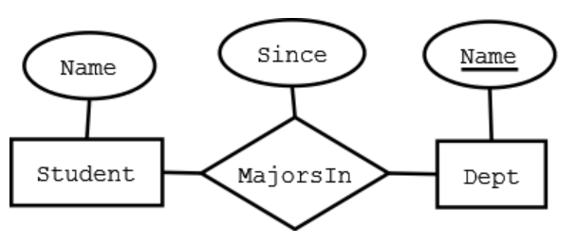
Relationships Summary
Relationship: connects two or more entities into an association/relationship
"John" majors in "Computer Science"
Relationship Type: set of similar relationships
Student (entity type) is related to Department (entity type) by MajorsIn (relationship type).
Notes:
Student entity contains all students like “John” and Dept entity contains all departments such as "Computer Science“ and the relationship contains all relationship sets between the two entities Student and Dept

Slide 26
Relationships Summary
Relationship Types may also have attributes in the E-R model. When they are mapped to the relational model, the attributes become part of the relation. Represented by a diamond on E-R diagram.
Relationship types can have descriptive attributes like entity sets
Relationships tend to be verbs or verb phrases; attributes of relationships are again nouns

Slide 27

Relationships Summary contd.
An attribute of a relationship type adds additional information to the relationship
e.g., "John" majors in "CS" since 2000
John and CS are related
2000 describes the relationship - it's the value of the since attribute of MajorsIn relationship type

Slide 28
Entity-Relationship Model Summary
E-R modeling is a conceptual level model
Proposed by P.P. Chen in 1970s
Entities are real-world objects about which we collect data
Attributes further describe the entities with particular values
Relationships are associations among entities
Entity set – set of entities of the same type
Relationship set – set of relationships of same type
Relationships sets may also have descriptive attributes
Represented by E-R diagrams

Slide 29
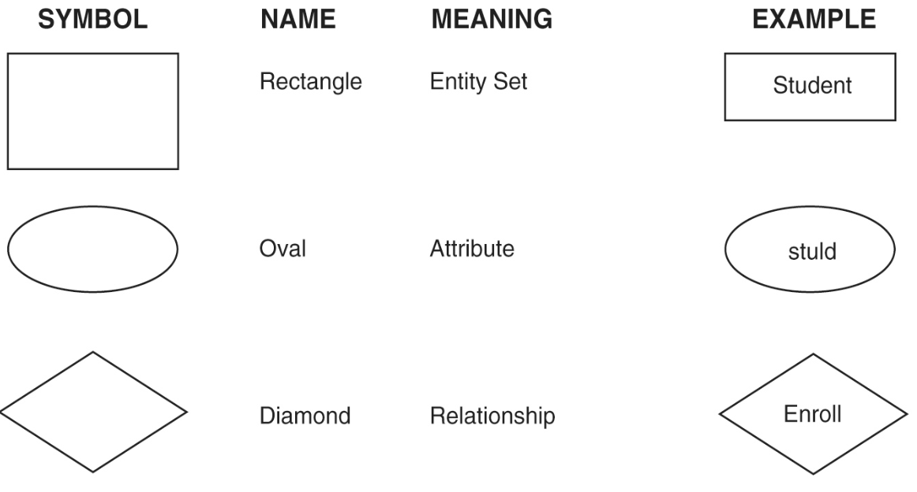

Slide 30
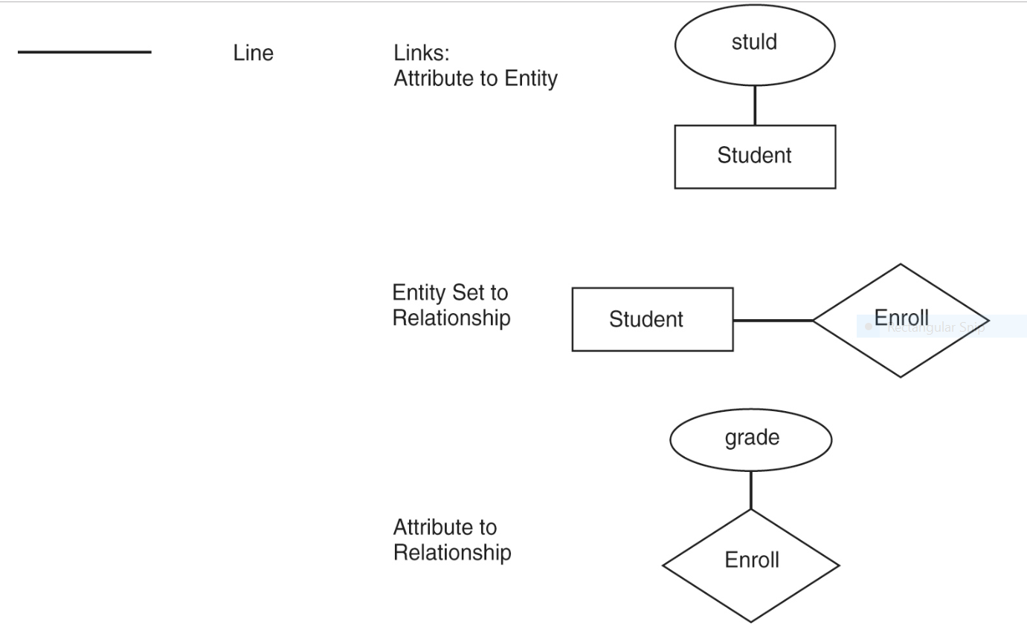

Slide 31
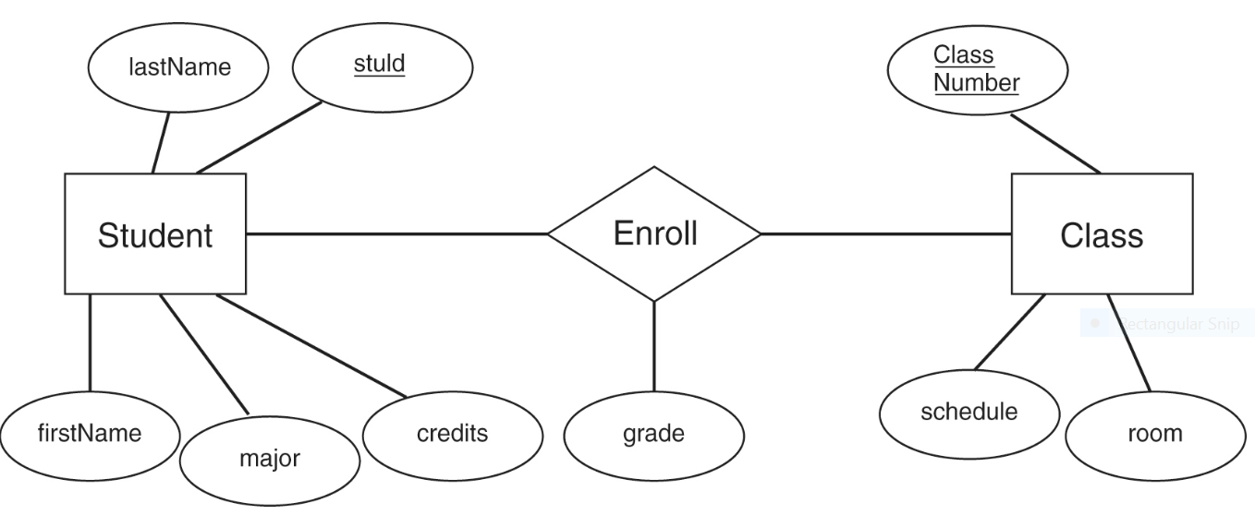

Slide 32
Degree of Relationship
The number of participating entities in a relationship defines the degree of the relationship.
Binary = degree 2
Ternary = degree 3
n-ary = degree

Slide 33
Binary relationship – links two entity sets; set of ordered pairs (most common)

Slide 34
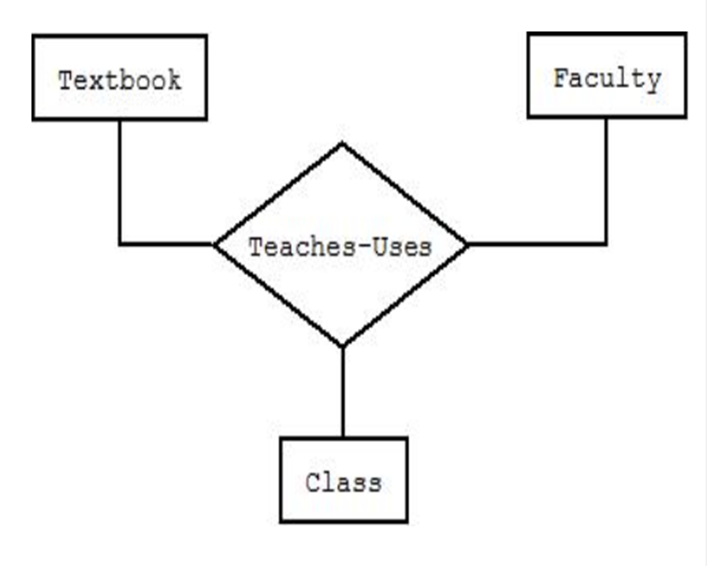
Ternary (multiway) relationship links three entity sets; ordered triples (rare)
Notes:
Ternary or three-way relationship

Slide 35
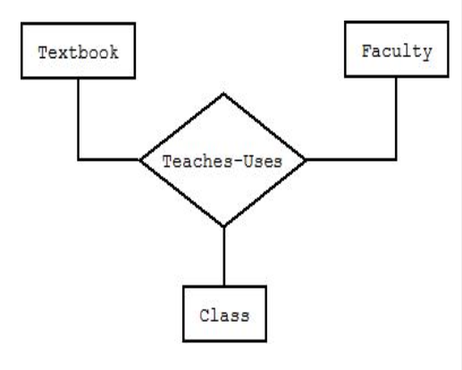
Degree of relationship The number of roles (entity participants) in the relationship
NOTE: Ternary relationships are rare.
N-ary – links n entity sets; ordered n-tuples (extremely rare). If a relationship exists among the entities, then all must be present. Cannot represent subsets.
If you have a ternary relationship, there must be 3 entities that relate simultaneously--a triple, not just a pair.
A four-way relationship would require a quadruple--all four, together represent one relationship.

Slide 36
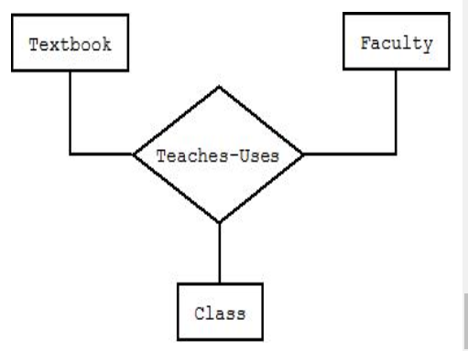
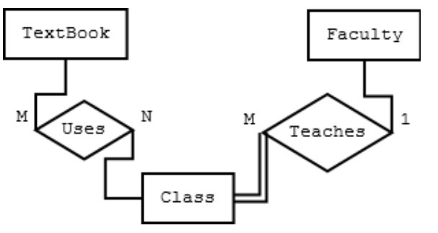
Degree of relationship Note: ternary relationships may sometimes be replaced by two or more binary relationships Semantic equivalence between ternary relationships and two binary ones are not necessarily the same.

Slide 37
Cardinality (Multiplicity) of Relationships
Cardinality is the number of entity instances to which another entity set can map under the relationship. This does not reflect a requirement that an entity has to participate in a relationship. Participation is another concept.
One-to-one: X-Y is 1:1 when each entity in X is associated with at most one entity in Y, and each entity in Y is associated with at most one entity in X.
One-to-many: X-Y is 1:M when each entity in X can be associated with many entities in Y, but each entity in Y is associated with at most one entity in X.
Many-to-many: X:Y is M:M if each entity in X can be associated with many entities in Y, and each entity in Y is associated with many entities in X ("many" =>one or more and sometimes zero)
Notes:
UML uses the term Multiplicity, whereas Data Modelling uses the term Cardinality

Slide 38
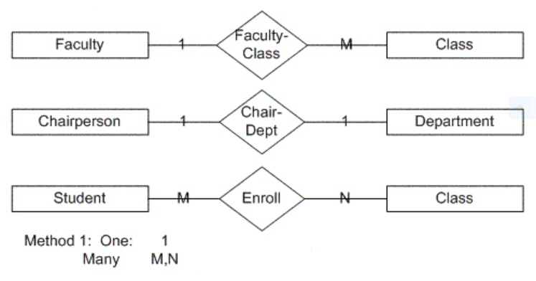
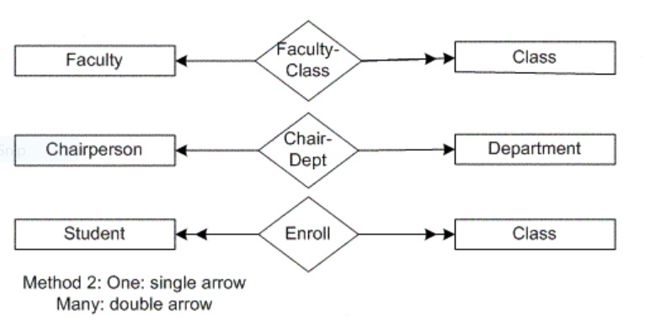
Cardinality notation

Slide 39
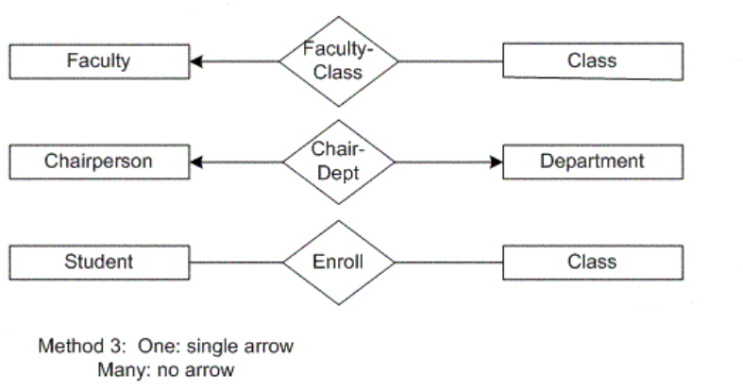
Cardinality notation: Chen’s notation, used in textbook (what we will use)
Notes:
Chen’s notation, used in textbook (what we will use)

Slide 40
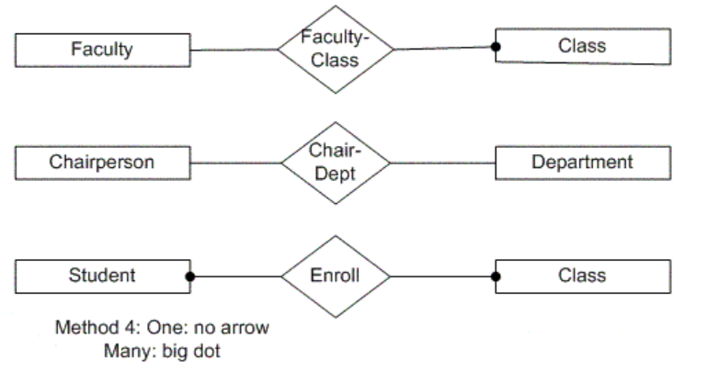
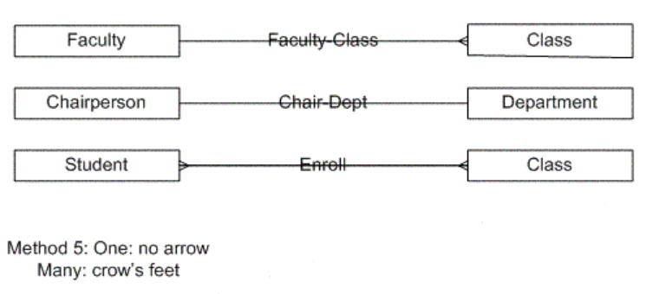
Cardinality notation

Slide 41
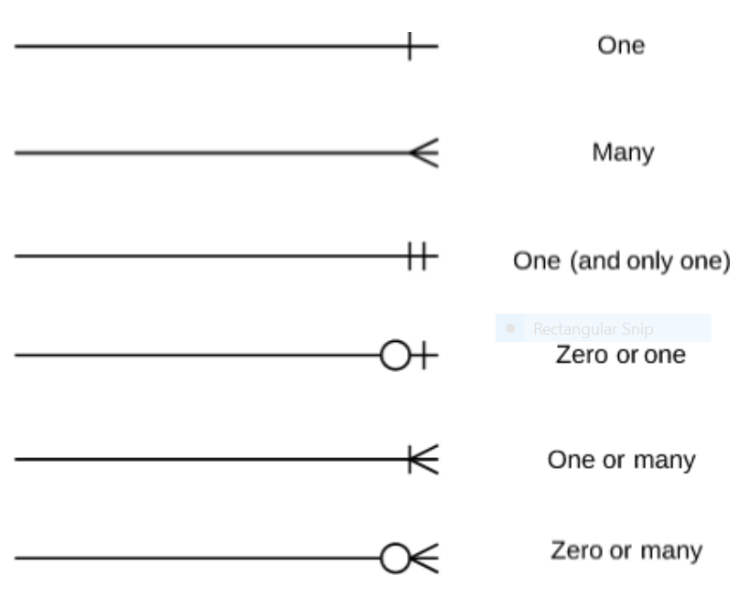
Cardinality and ordinality
Cardinality refers to the maximum number of times an instance in one entity can relate to instances of another entity.
Cardinality and ordinality are shown by the styling of a line and its endpoint, according to the chosen notation style.
Notes:
This is Crow’s foot notation. There are a number of notations used to present cardinality in ER diagrams. Chen, UML, Crow’s foot, Bachman are some of the popular notations.

Slide 42
Cardinality and ordinality
Ordinality, on the other hand, is the minimum number of times an instance in one entity can be associated with an instance in the related entity.
Notes:
This is Crow’s foot notation. There are a number of notations used to present cardinality in ER diagrams. Chen, UML, Crow’s foot, Bachman are some of the popular notations.

Slide 43
EXAMPLE FROM TEXT BOOK

Slide 44
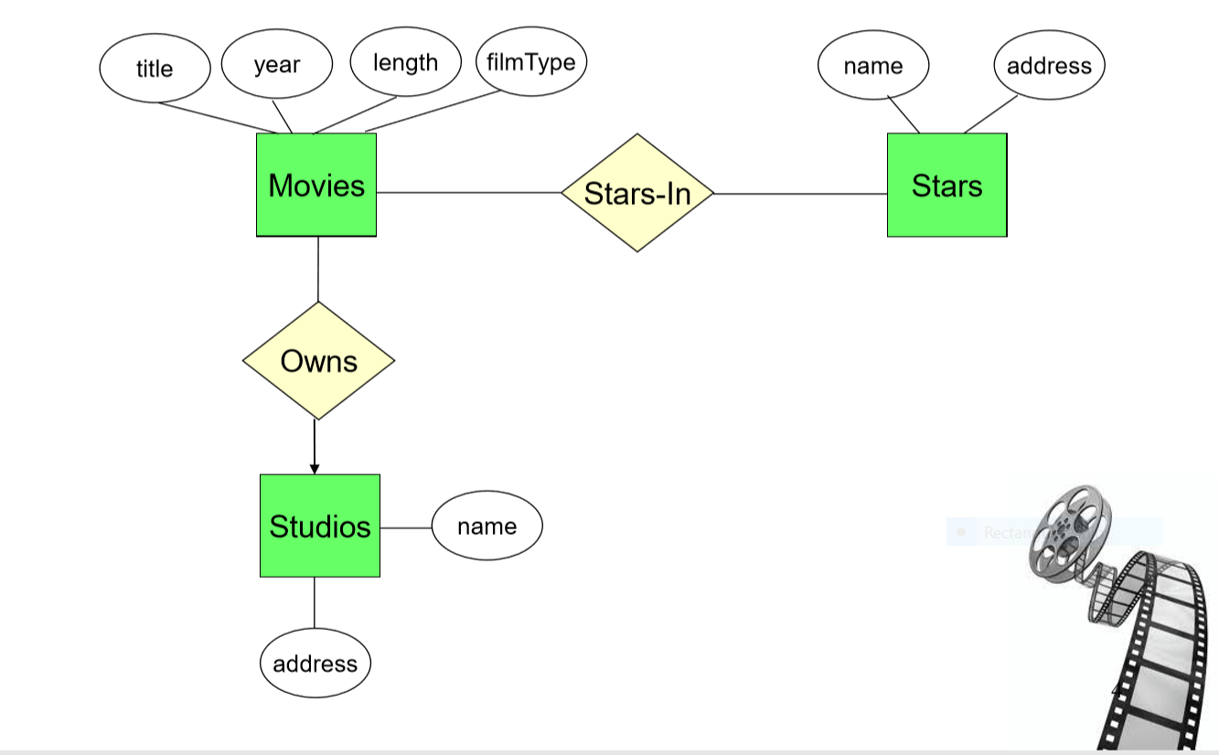

Slide 45
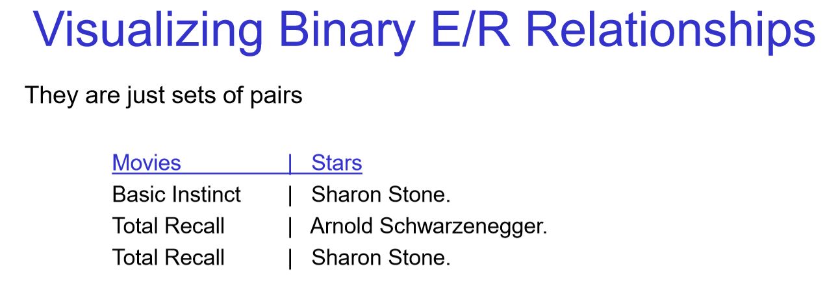
Notes:
One actor could acts in several movies and a movie could have several actors

Slide 46
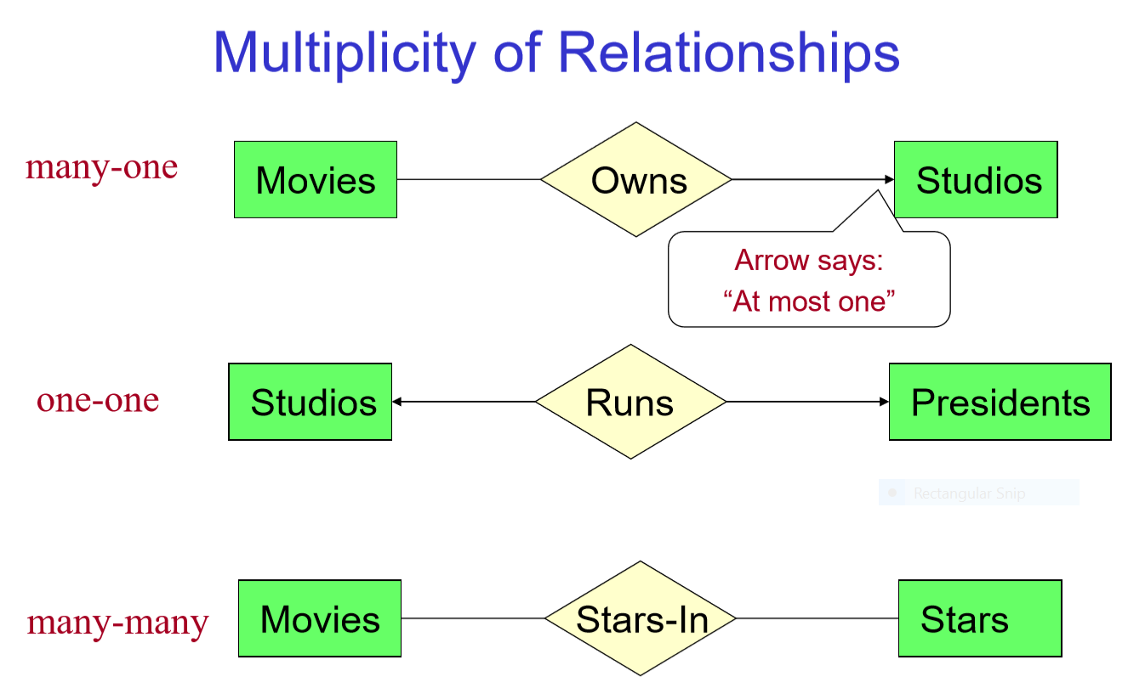

Slide 47
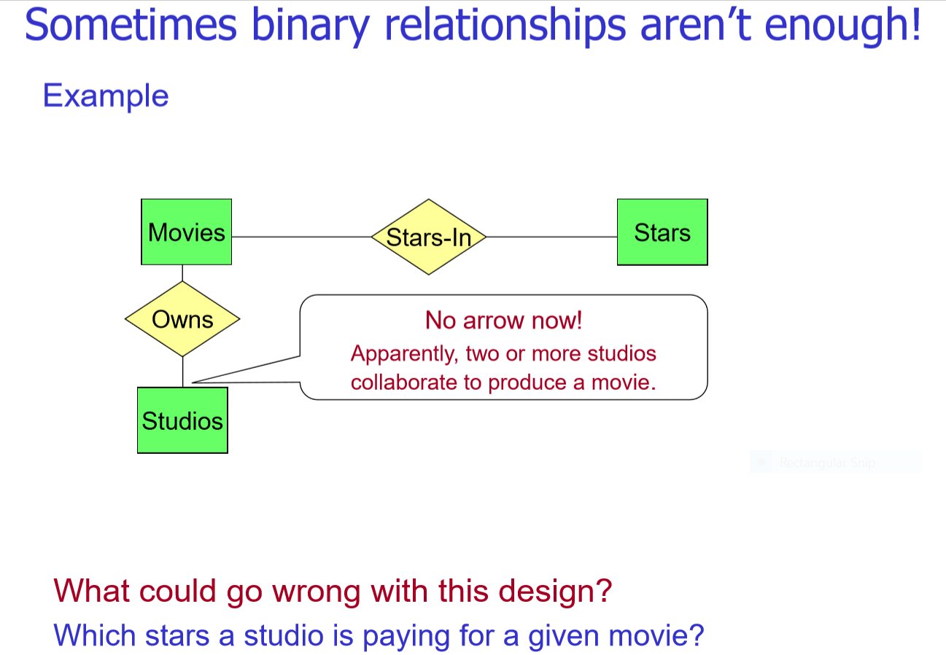
Notes:
Here we are trying to connect two binary relationships Movies/Stars and Movies/Studios and asking the question about payment for stars

Slide 48
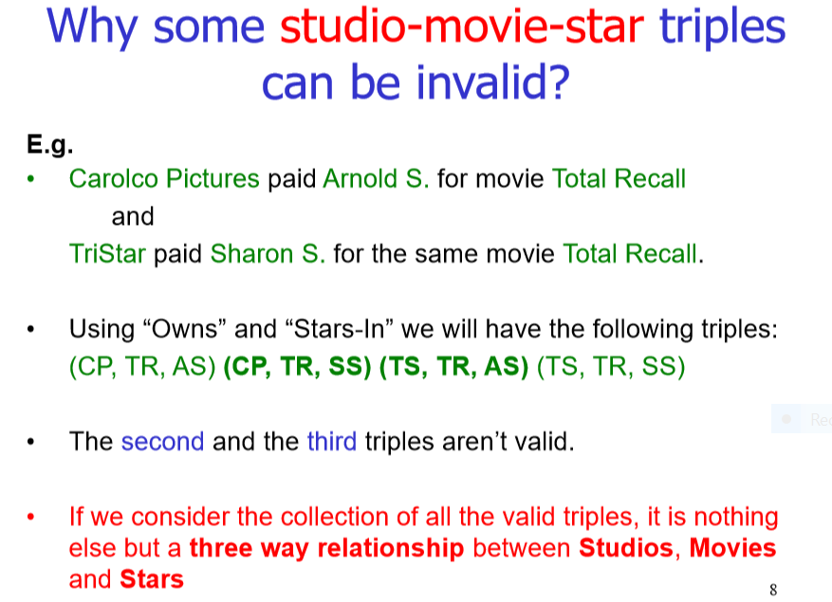

Slide 49
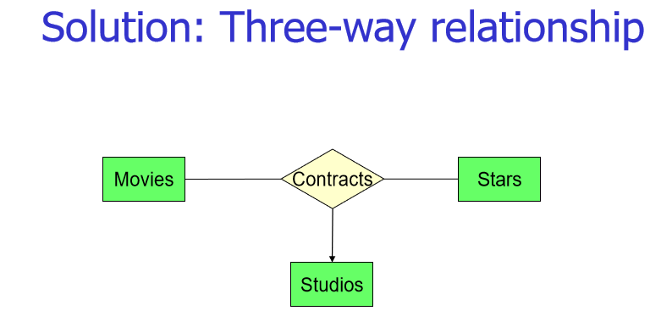

Slide 50
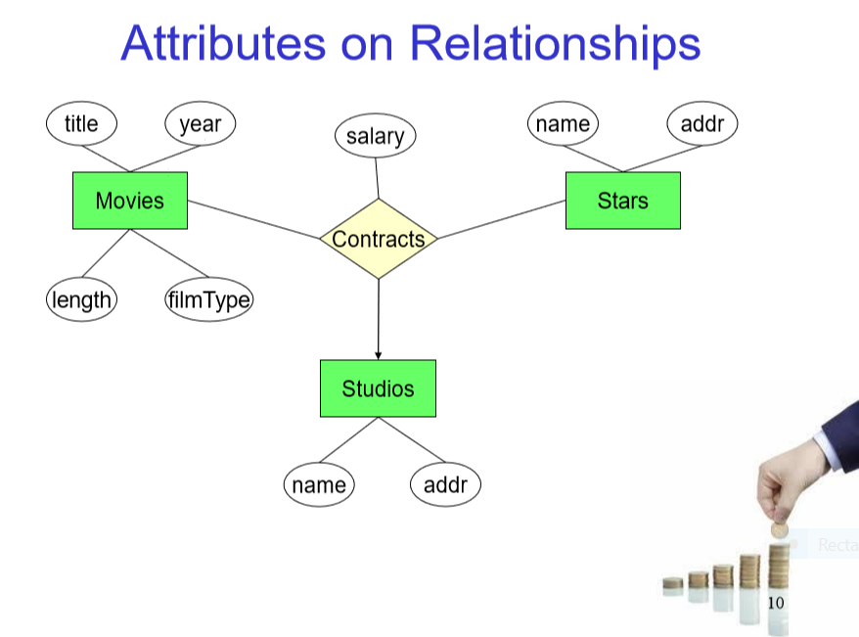
Notes:
Salary of the star as is an attribute of the relationship ‘Contracts’ because it is the payment a star receives from a particular studio and a specific movie

Slide 51
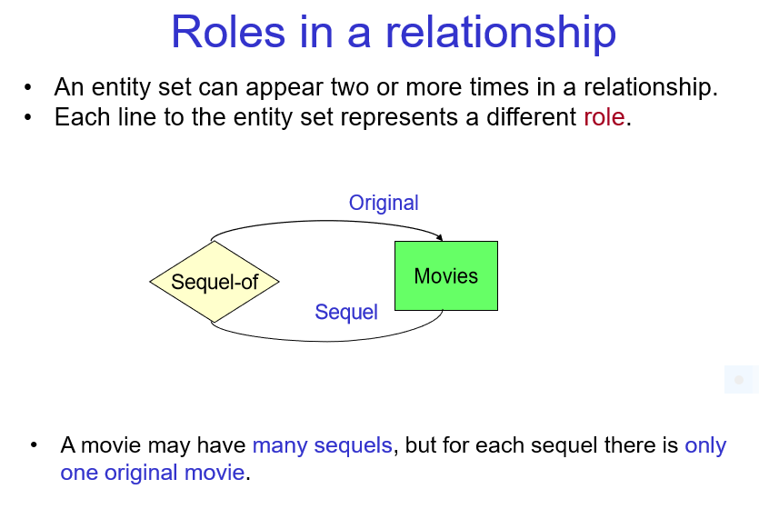

Slide 52
EXERCISE

Slide 53
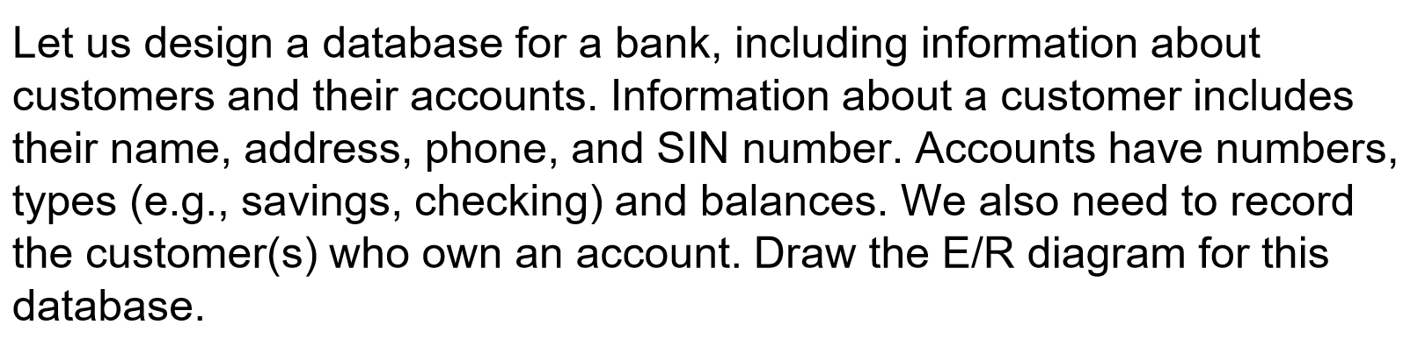

Slide 54
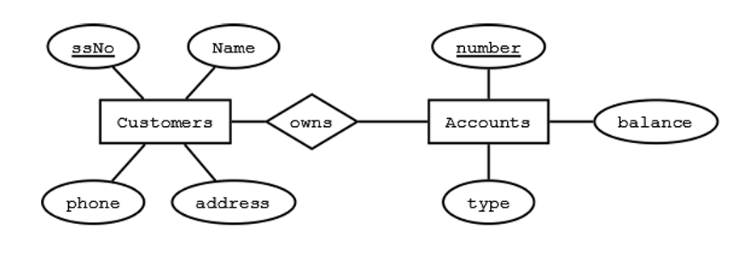

Slide 55
Change your diagram so an account can have only one customer

Slide 56
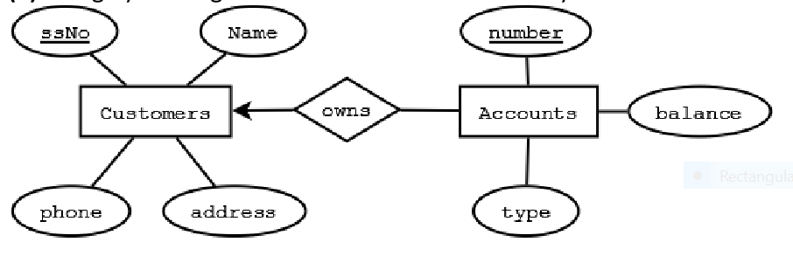
Change your diagram so an account can have only one customer

Slide 57
Further change your diagram so a customer can have only one account

Slide 58
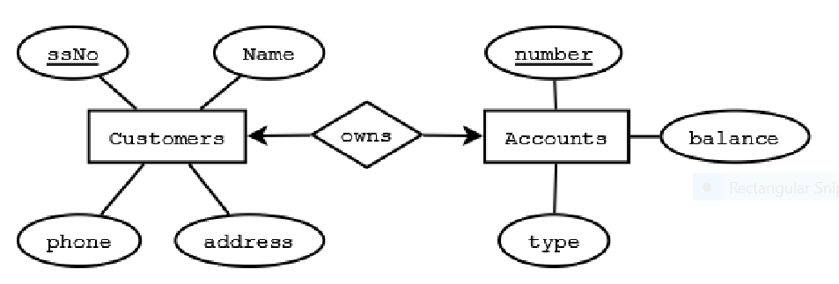
Further change your diagram so a customer can have only one account

Slide 59
Change your original diagram so that a customer can have a set of addresses (which are street-city-state triples) and a set of phones

Slide 60
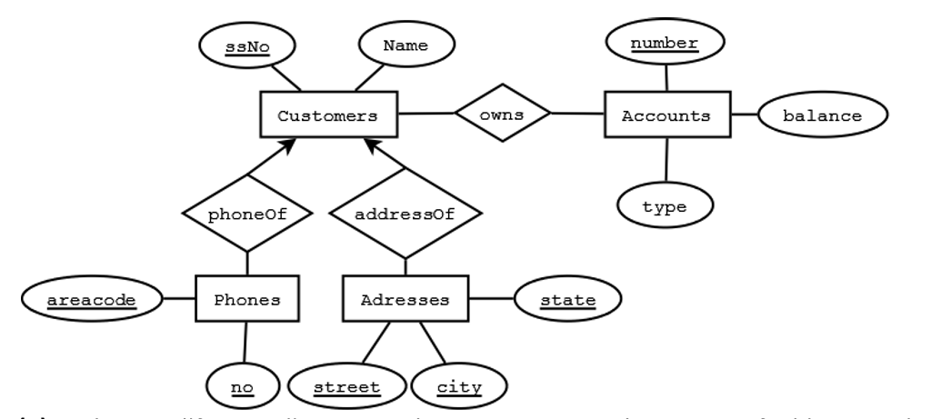
Change your original diagram so that a customer can have a set of addresses (which are street-city-state triples) and a set of phones

Slide 61
Further modify your diagram so that customers can have a set of addresses, and at each address there is a set of phones

Slide 62
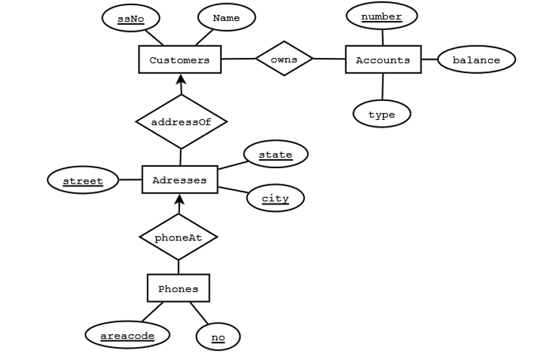
Further modify your diagram so that customers can have a set of addresses, and at each address there is a set of phones

Slide 63
About using notation
You might have observed that online resources have different notations for E/R modelling
We will use notation as given in the textbook for assignments and midterms

Slide 64
Assignment 01

Slide 65
What to do?
Requirements analysis
A database is intended to model a real world enterprise
Identify:
What data are to be stored in the database?
What applications are required to work with the database?
Which are the most frequent, and the most important operations?
This will help in identifying the entity sets, relations among them and attributes i.e. relevant to the design (we are not modelling everything related to the enterprise)

Slide 66
What to do?
Design the conceptual model
For the given scenario
Identify the different entities: what are the unique nouns in the description?
Identify the relationships: what verbs are used to connect the nouns?
What roles, cardinalities, and constraints are described in the narrative?
Sketch the ER model on paper first. Include text on the drawing as a narratives describing what assumptions have you made in deciding roles, cardinalities and constraints.

Slide 67
Acknowledgment:
Some slides/content taken from material presented in these courses/articles:
CSC 370 – Database Systems Introduction by Alex Thomo http://webhome.cs.uvic.ca/~thomo
Database Management Systems CS 370 http://jcsites.juniata.edu/faculty/rhodes/dbms/syllabus.htm#GRADING
Candidate, Primary, Alternate, Super and Composite key types in DBMS (SQL) a video and the related blog post
https://sqlwithmanoj.com/2014/09/15/db-basics-what-are-candidate-primary-composite-super-keys-and-difference-between-them

Slide 68
Acknowledgment:
Some slides/content taken from material presented in these courses/articles:
4. What is a partial key in database systems? https://www.quora.com/What-is-a-partial-key-in-database-systems
5. https://creately.com/blog/diagrams/er-diagrams-tutorial/
6. https://ion.uwinnipeg.ca/~rmcfadye/2914/hypergraph/partial.html
7. In an E/R diagram, can a relationship have attributes?
https://www.quora.com/In-an-E-R-diagram-can-a-relationship-have-attributes

Slide 69
Reading material
Start reading Chapter 4, Section 4.1 (text book) uploaded on Connex
Some other material related to E/R modelling and database design (read if interested)

Slide 70
More on E/R model next lecture

Slide 71
Thank you!
Questions?

